Slide 1


Upgrading from Xamarin to .NET 6
Microsoft Confidential
Speaker Name
Speaker Title
name@email.com
@twitterAccount

Slide 2
Overview
.NET 6 unifies Xamarin SDKs into .NET
Single Base Class Library (BCL)
Single project system
Single shipping vehicle

Slide 3

Xamarin SDKs are now
.NET for
Android
iOS
macOS
Mac Catalyst
tvOS

Slide 4
Xamarin SDKs are now
.NET Multi-platform App UI (MAUI)
.NET for
Android
iOS
macOS
Mac Catalyst
tvOS

Slide 5
.NET MAUI is the most productive way to develop native apps that perform great on any device that runs Android, iOS, macOS, or Windows from a single codebase.

Slide 6




How does .NET MAUI work?
.NET Multi-platform App UI
.NET for Android
.NET for iOS / Mac Catalyst
WinUI
.NET Base Class Library (BCL)
App Code
.NET Runtime
Android
iOS
macOS
Windows
iOS
macOS
Notes:
How is it native?
Everything starts with your app code. This is where you want to spend all your time being productive. And you want to deliver your app on 1+ devices
The first layer of the technology cake is the native platform SDK. This what Google, Android, and Microsoft ship for those platforms
So how do we get from our .NET app code to those platforms and running on devices?
First we need something that can run .NET code: the .NET Runtime. (Yes, it uses MonoVM on mobile and Mac, and CoreCLR on Windows, but that’s not terribly important because...)
Next we need a common .NET API we can write our code against, and that’s the Base Class Library (BCL). New in .NET 6 app runtimes use the same BCL.
To use .NET against native platform SDKs we need a .NET representation of them. We do this via binding a .NET API and implementation to the native API. When you call a native method from C#, it’s just as if you had done it from Obj-C, Swift, Java, Kotlin, or C++.
The final layer of the cake that really makes it delicious is .NET MAUI. .NET MAUI provides a rich library of controls, layouts, and services that work across all of the platforms supported, so you need only master one API to get native apps.
(next slide) With .NET MAUI, all of that complexity is delivered in a single framework that gives you access to it all.

Slide 7
How does .NET MAUI work?
App Code
.NET Multi-platform App UI
iOS
macOS
Notes:
With .NET MAUI, all of that complexity is delivered in a single framework that gives you access to it all.

Slide 8
Pre-requisites
For best success upgrading to .NET 6 we recommend:
Upgrade any PCL projects to .NET Standard
Upgrade Xamarin.Forms projects to version 5.0
Upgrade packages.config to PackageReference
Recommended tools:
Visual Studio 2022 for Windows or Mac (link)
.NET 6 (link)
.NET Upgrade Assistant (link)

Slide 9
Upgrade Steps
Run .NET Upgrade Assistant to:
Backup your existing project
Convert *.csproj to SDK Style
Migrate namespaces from Xamarin.* to Microsoft.Maui.*
Review and replace NuGet packages with .NET 6 compatible versions
Open in Visual Studio 2022 to:
Address NuGet dependencies
Build and fix errors
Estimated time: less than a day, more than 5 minutes...depending

Slide 10
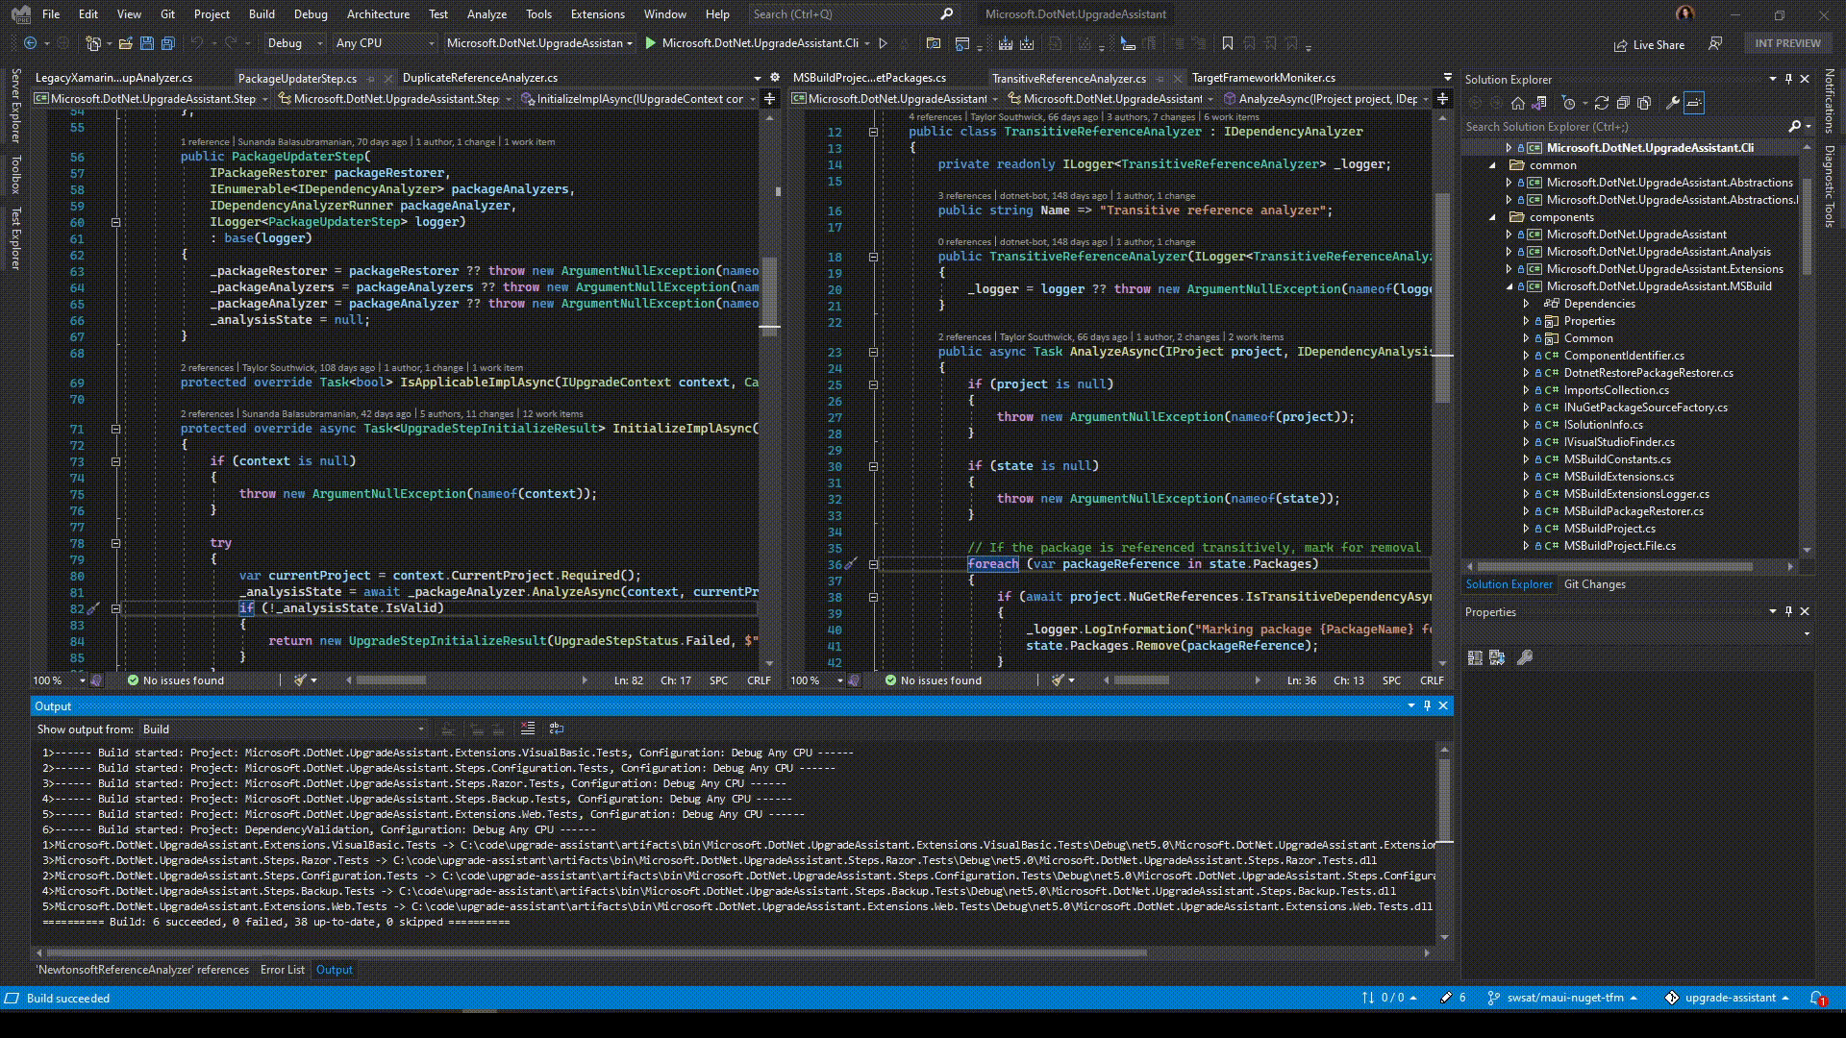
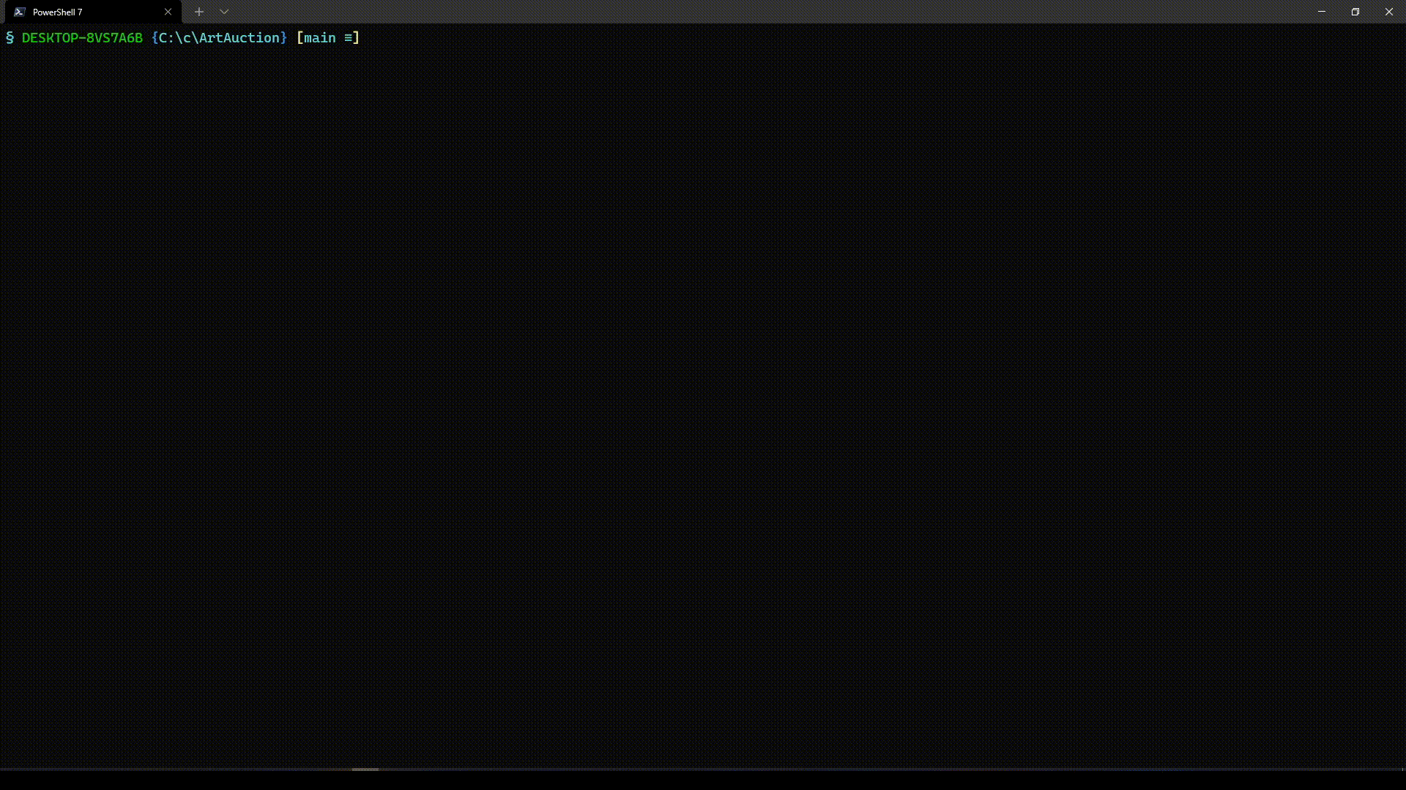
.NET Upgrade Assistant

Slide 11
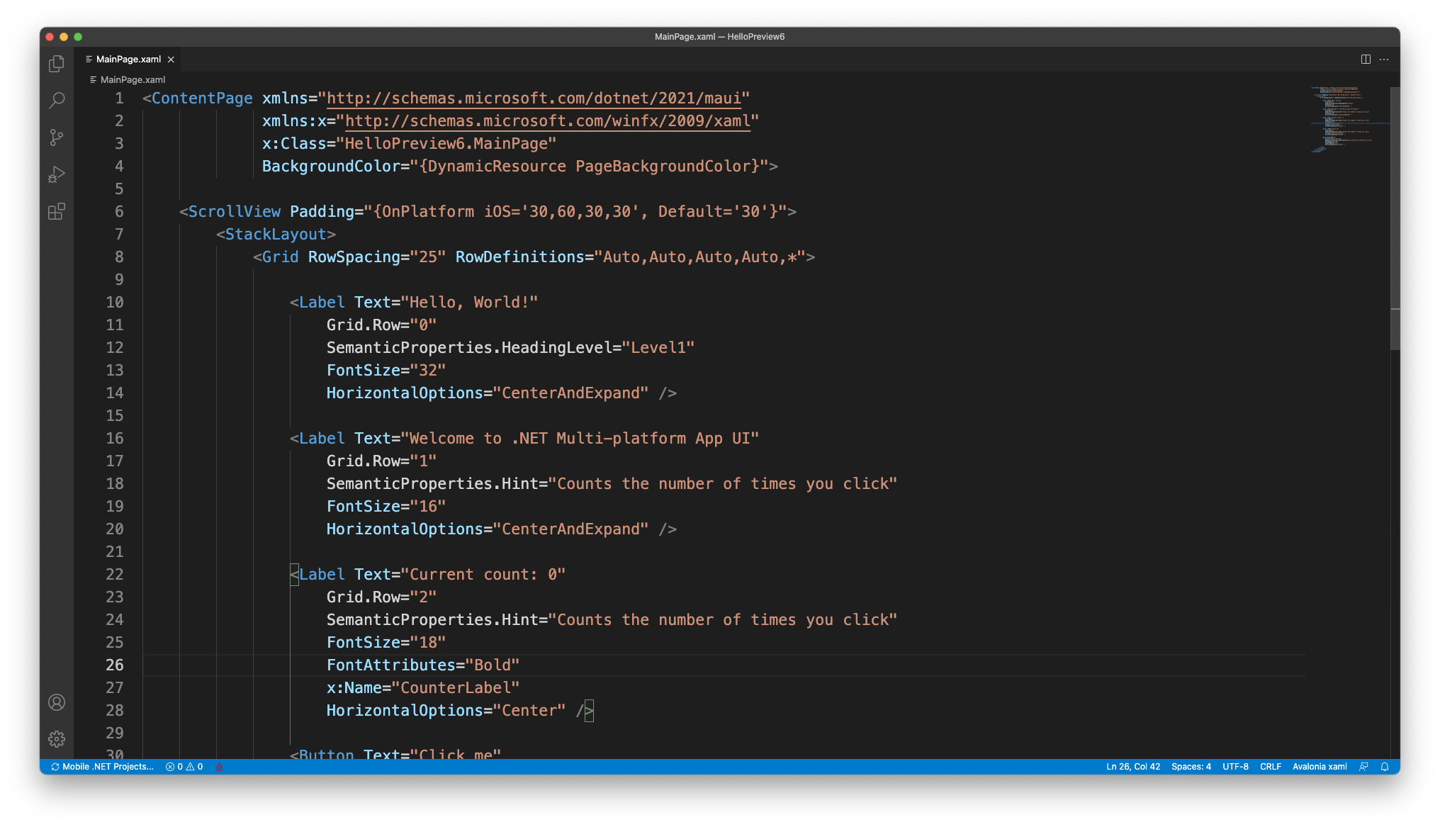
Xamarin.Forms to Microsoft.Maui
.NET MAUI uses the same XAML and control naming

Slide 12
Xamarin.Forms to Microsoft.Maui
.NET MAUI can run Effects and Custom Renderers
Update namespaces in your platform implementation to Microsoft.Maui
Register your Effect in Startup.cs:
Register your Renderer in Startup.cs:
No change in XAML needed
appBuilder.ConfigureEffects(builder => {
builder.Add<FocusRoutingEffect, FocusPlatformEffect>();
});
appBuilder.ConfigureMauiHandlers(builder => {
#if __ANDROID__
handlers.AddCompatibilityRenderer(typeof(CustomEntry), typeof(Droid.Renderers.CustomEntryRenderer));
#endif
});

Slide 13
Xamarin.Forms to Microsoft.Maui
(Optional)
Migrate Effects and Renderers to new Handler architecture
Migrate multi-project solution to single project
Examples and resources: https://github.com/jsuarezruiz/xamarin-forms-to-net-maui

Slide 14
NuGet Compatibility
How do you know if you need to upgrade or replace a NuGet dependency?
Case 1
NuGets that are .NET Standard and do not reference any Xamarin.Forms types will most likely work as-is.
Case 2
NuGets that reference Xamarin.Forms types need to be updated to Microsoft.Maui.Controls types and republished with .NET 6 TFMs (Target Framework Moniker)

Slide 15

Thanks for joining !

